Slide 1
Outline
Literature
Anderson, Laurent & Yantis, 2011
Sandry & Ricker, 2020
Experiment changes
Pilot Data
Response Time
Discriminability and Criterion

Slide 2
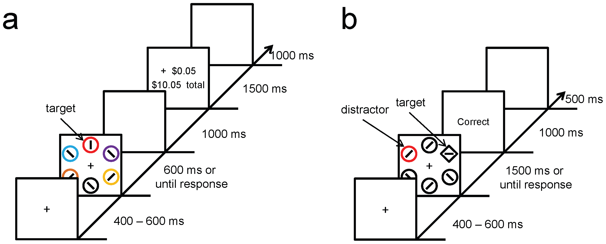
Experiment 1: Training (a) and Test (b) Phase
Learned value magnifies salience-based attentional capture
Anderson et al., 2011

Slide 3
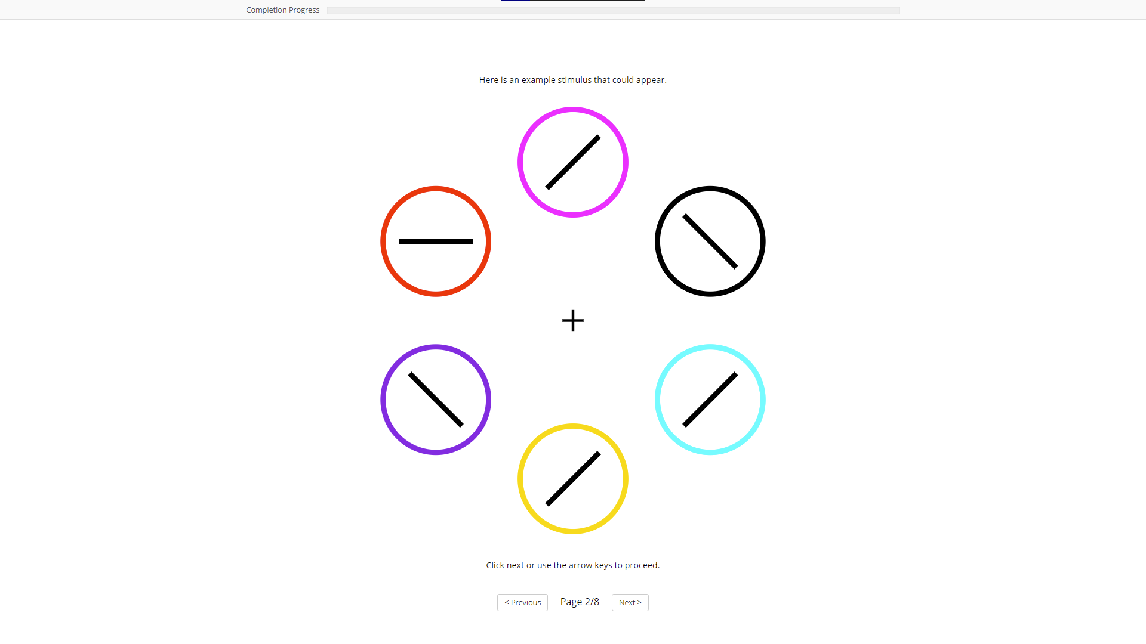

Slide 4
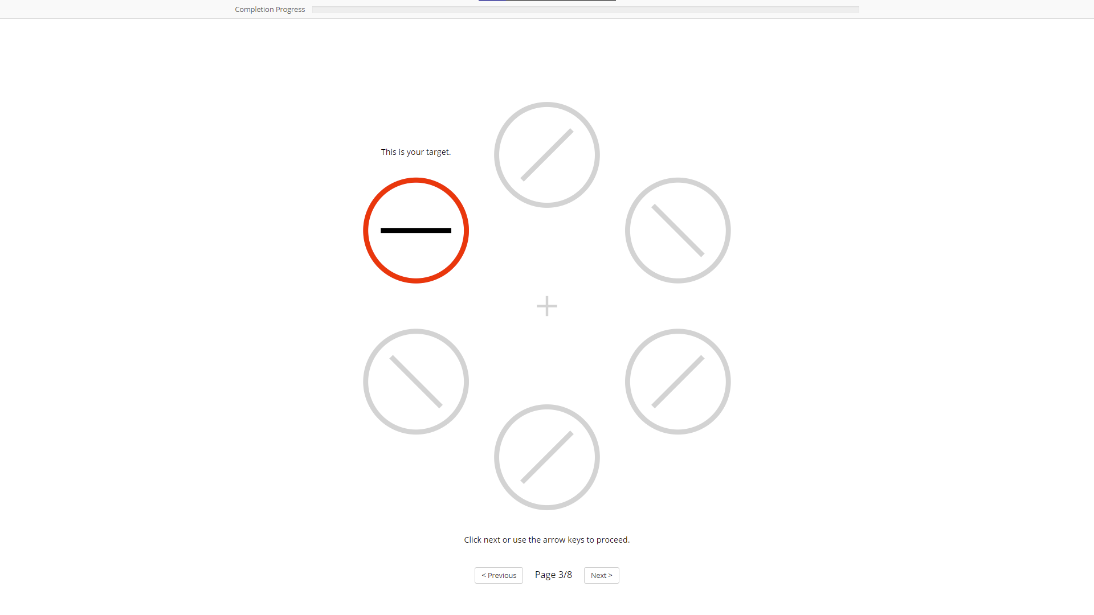

Slide 5
Training Phase
Participants identified the orientation of a line contained within red or green circle
High Reward Targets (Red)
P(5¢) = .80 P(1¢) = .20
Low Reward Targets (Green)
P(5¢) = .20 P(1¢) = .80
Anderson et al., 2011

Slide 6
Experiment 1: Training (a) and Test (b) Phase
Learned value magnifies salience-based attentional capture
Anderson et al., 2011

Slide 7
Test Phase
Participants identified orientation of line contained within shape singleton (square)
One distractor was colored in either high-value (red) or low-value (green) color
Color was not relevant to task
Anderson et al., 2011

Slide 8
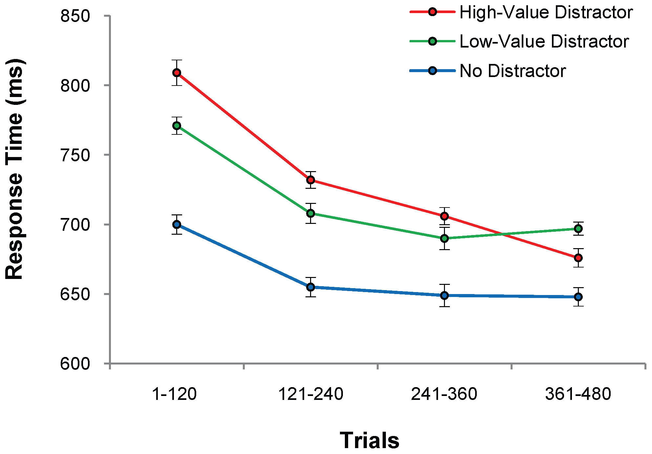
Test Phase: Higher RT for Previously Rewarded Distractors
High-Value: 728 (3.8)
Low-Value: 710 (3.9)
No Distractor: 655 (5.5)
n = 18
Anderson et al., 2011

Slide 9
Experiment 2: Isolating Effects of Selection History
Red Targets
Green non-target
No reward feedback given
Compensation based on flat rate
Test phase was kept the same
Anderson et al., 2011

Slide 10
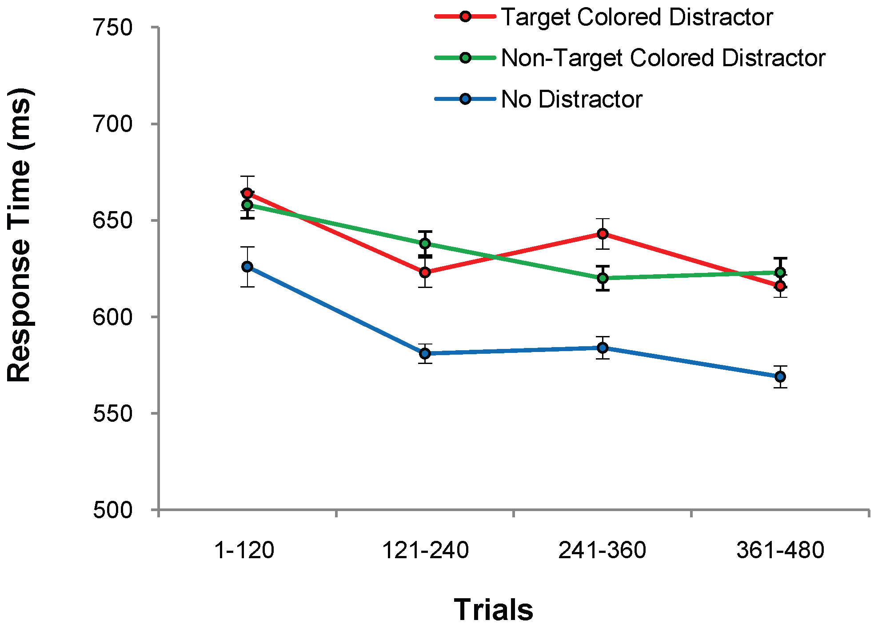
Test Phase 2: No Differences Between Distractor Conditions
Target: 634 (4.8)
Non-target: 632 (4.1)
No Distractor 588 (6.3)
n = 18
Anderson et al., 2011

Slide 11
Rewarded Distractors Resulted in Higher RT
Experiment 1
High Reward: 728 (3.8)
Low Reward: 710 (3.9)
No Distractor: 655 (5.5)
Experiment 2
Target Distractor: 634 (4.8)
Non-target Distractor: 632 (4.1)
No Distractor: 588 (3.6)
Anderson et al., 2011

Slide 12
Summary so Far
Reward-associated stimulus features influence attentional capture automatically and independently of physical salience or prior selection history
Since attention is critical for memory, can value-driven attentional capture impact memory in other irrelevant contexts?

Slide 13
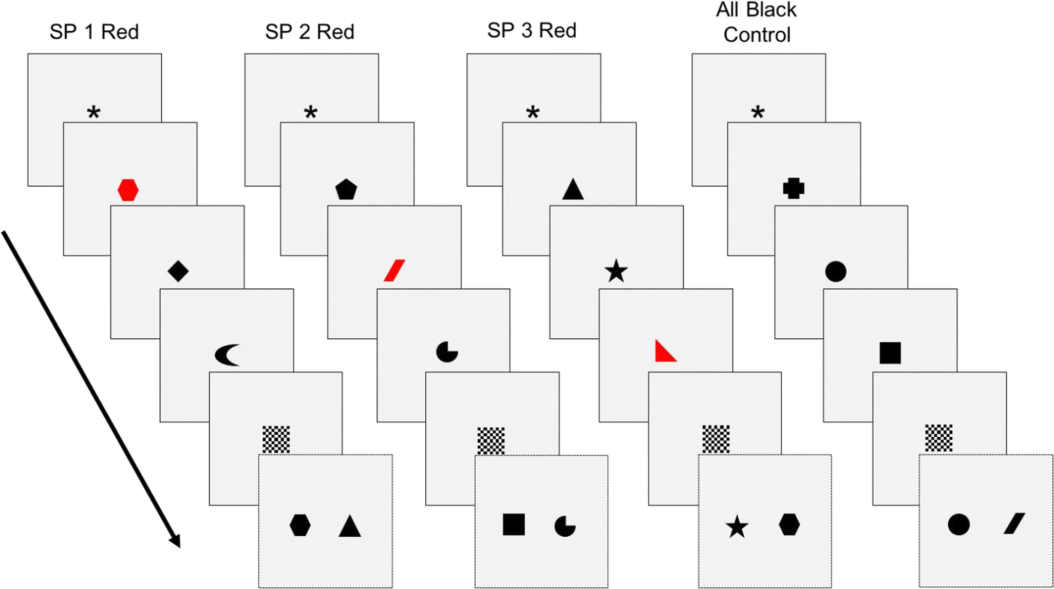
Recognition Task
Each item shown for 0.5s
Black = 3 pts
Red = 25 pts
High-reward vs. Equal-reward
Prioritization within visual working memory reflects a flexible focus of attention
Sandry & Ricker, 2020

Slide 14
Recognition Task
Directions
Characters
Խ Կ Ջ
Sandry & Ricker, 2020

Slide 15
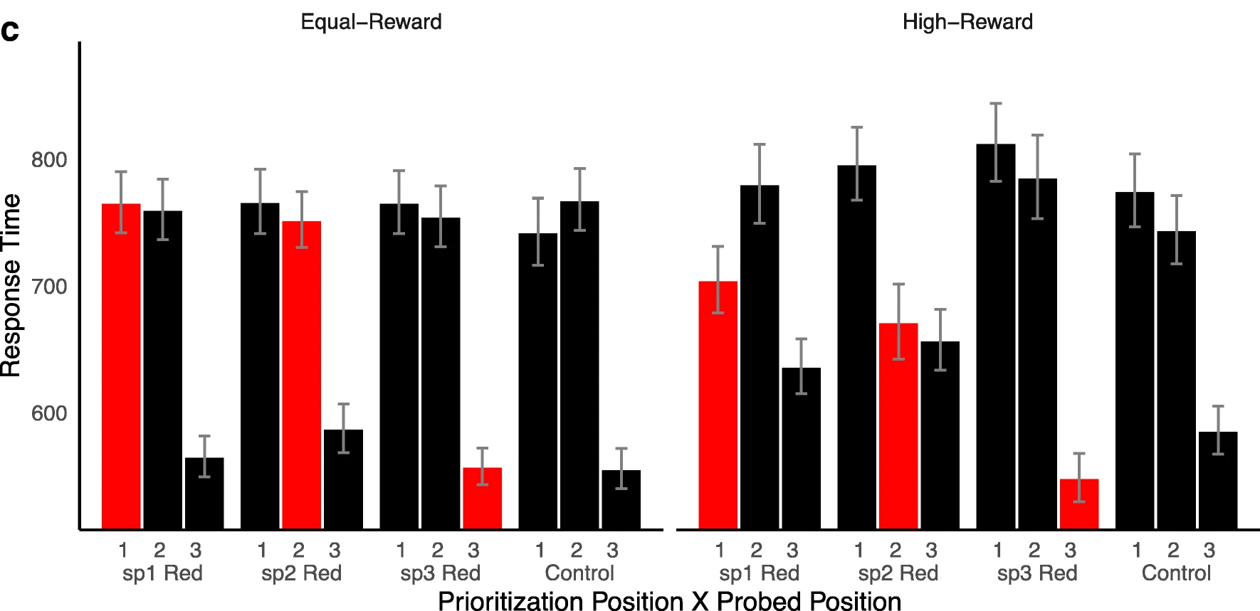
Description of Results

Slide 16
A S D : A

Slide 17
A S D : A

Slide 18
A S D : S

Slide 19
A S D : D

Slide 20
A S D : A

Slide 21
A S D : A

Slide 22
A S D : D

Slide 23
A S D : A

Slide 24
A S D : A

Slide 25
A S D : S

Slide 26
A S D : D

Slide 27
A S D

Slide 28
A S D

Slide 29
Response Time

Slide 30
Response Time

Slide 31
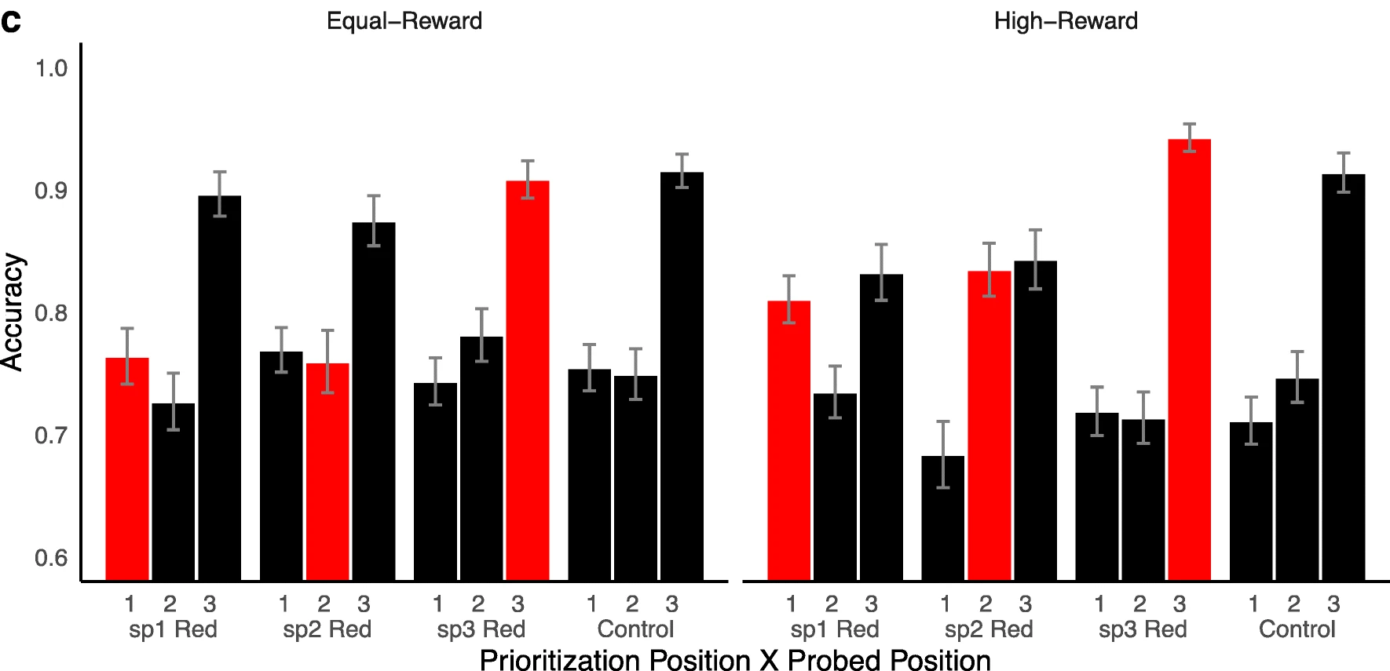
Accuracy

Slide 32
Summary so Far
Reward-associated stimulus features influence attentional capture automatically and independently of physical salience or prior selection history
Attention can be flexibly allocated to maintain memory of rewarded stimuli with some resource trade-offs
Sandry & Ricker’s study does not show if the attentional effects of rewarded stimuli automatically transfer over to a memory task
The use of 2AFC prevents discriminability and criterion analyses

Slide 33
The Current Study

Slide 34
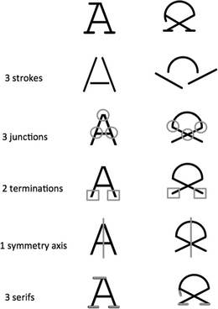
Key Changes
Anderson, Laurent & Yantis Task
Training trials reduced from 240 to 200
Money was replaced with 2 and 10 point rewards
Sandry & Ricker Task
90 Characters from Brussels Artificial Character Sets
Black, red ,and green characters: ASDFGHJKL
No rewards in-between trials
2AFC changed to same/different task
BACS: The Brussels Artificial Character Sets for studies in cognitive psychology and neuroscience
Vidal, C., Content, A., & Chetail, F. (2017)

Slide 35
Training Phase: RT and Accuracy

Slide 36
Response Time by Color and Target Position

Slide 37
Hit Rate by Color Condition and Target Position

Slide 38
False Alarm Rate Collapsed by Color

Slide 39
False Alarm Rate by Color Position

Slide 40
A S D : A Same/Different Z C V : B

Slide 41
A S D : S Same/Different Z C V : B

Slide 42
A S D : D Same/Different Z C V : B

Slide 43
A S D : D Same/Different Z C V : B

Slide 44
False Alarm Rate by Color Position

Slide 45
d-prime by Color Condition and Target Position

Slide 46
Criterion

